Slide 1

goBus
Team-8
Online Bus Booking System
Team Members
Poorvi R
Namratha S B
Gaddagunta YuvaMadhuri
Vandana Venkatraman Naik
Kalabandalapati Sai Prasanna
Siddartha H P
Kota Sai Naresh
Nallapuneni Naveen
Sivarathri Venkata Gopi

Slide 2
Team Distribution
Employee ID | Name | Backend Team | Frontend Team
2497933 | Siddartha H P(T L) | 🗸
2500809 | Sivarathri Venkata Gopi |  | 🗸
2500395 | Nallapuneni Naveen | 🗸
2500928 | Poorvi R |  | 🗸
2500326 | Vandana Venkatraman Naik |  | 🗸
2499849 | Gaddagunta Yuva Madhuri | 🗸 (Backend Lead)
2500420 | Kota Sai Naresh | 🗸
2500786 | Kalabandalapati Sai Prasanna | 🗸
2500982 | Namratha S B |  | 🗸 (Frontend Lead)

Slide 3

Introduction
Abstract
Tools and Technologies used
Architecture
Block Diagram
Modules(parent)
Modules(child)
Work Flow Diagram of Admin
Work Flow Diagram of Passenger
Project Screenshots
Running Applications in Front-End and Back-End
Testing
Junit
Postman
Advantages
Future Work
Conclusion
INDEX

Slide 4
Introduction
The Online Bus Booking System is a system that manages the bus company booking or ticketing processes.
On the system administrator side, admin can manage the list of buses, locations, schedules and list of booked schedules.
Passenger can simply login to the site and find his/her desired schedule and location of the Bus .

Slide 5
Abstract
The main objective of our application is to create a dynamic and responsive Java application to allow a user to register to the application and search for the buses availability.
This application helps passengers to search for the buses availability and book it online.

Slide 6
Tools and Technologies
Front-End
Server-side
01
02
Angular
Spring Boot
Back-End
Server
03
04
Java 8, MYSQL, Hibernate, Maven
Tomcat

Slide 7
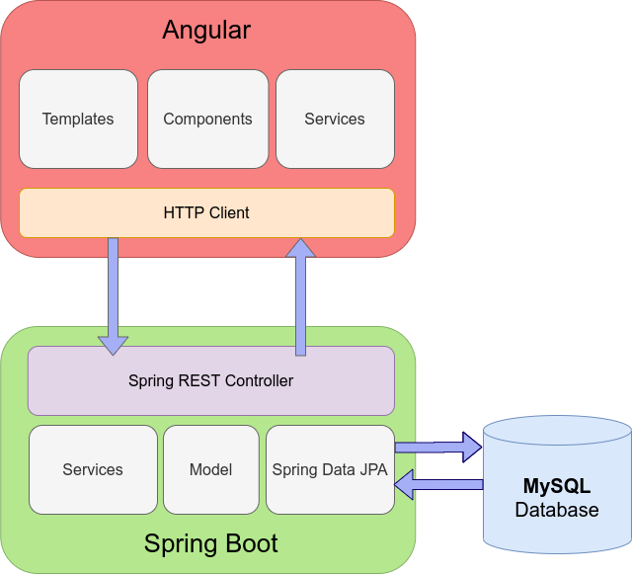
Architecture

Slide 8
Block Diagram
Customer/Passenger
Admin
Register,
Login,
Check Availability,
Book
Online Bus Ticket Reservation System
Home Page, Bus List, Route,
Schedule, Booked, User’s
Business Logic
Connected to Database

Slide 9
Parent Modules
Admin Module
User Module
Login to the portal
Admin can add/remove buses schedule
Update the details for passenger schedule
Register to the application
Login to the application
Search for the available buses
Booking the bus

Slide 10
Child Modules
In Admin Portal:
Bus List Page -This is the page where buses are listed and where can admin users can manage the buses.
Location -This page helps to organize the bus company location route. At this page, admin can manage the list of locations.
Schedule Page -This is the page where all bus route schedules are listed. At this page, admin can create, update, and delete and bus route schedule for booking.
Booked Page -The page where the passenger's booked schedules are listed. Admin can update the details and payment status of passenger schedule.
Users Page -The page where are admin users of the system are listed and can be managed.

Slide 11
Child Modules
In Passenger Portal:
Home Page -The welcoming page for the passenger when he/she browses the website. On this page, passenger can find his/her desired location and schedules.
Schedule Page -The page where can passenger see all bus company route schedules.

Slide 12
Work Flow Diagram - Admin
Add Bus details
Admin
Login
View Bus details
Remove Bus details
User Management
Logout

Slide 13
Work Flow Diagram - passenger
Welcome Page
Passenger
Search for buses
Login/
Register
Schedule page

Slide 14
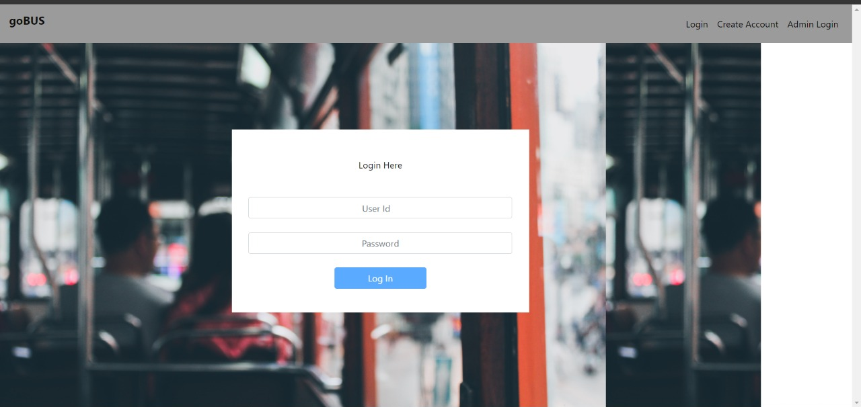
Project Screenshots
Home Page

Slide 15
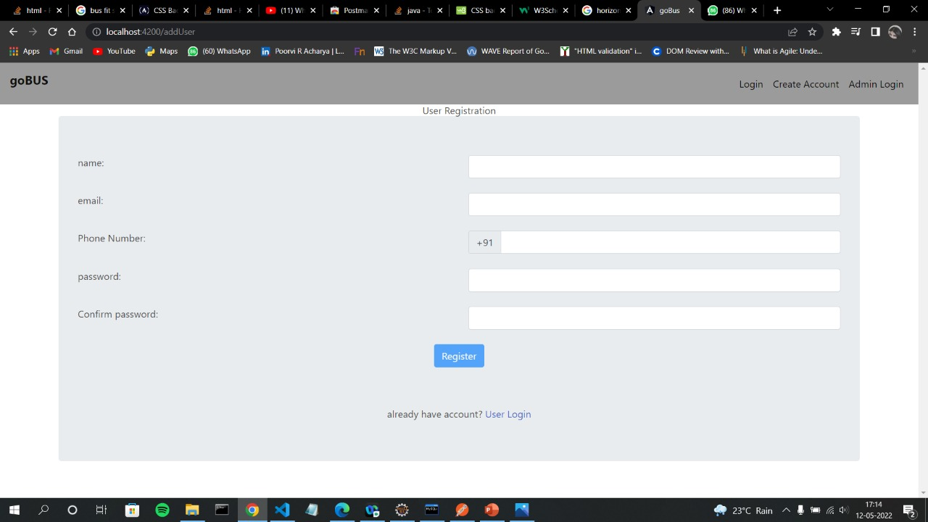
Project Screenshots
User Registration Page

Slide 16
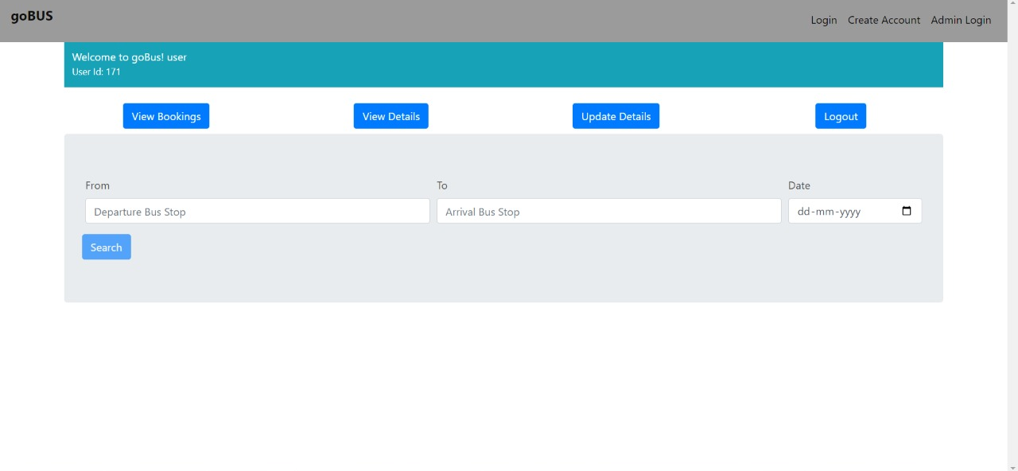
Project Screenshots
User Page

Slide 17
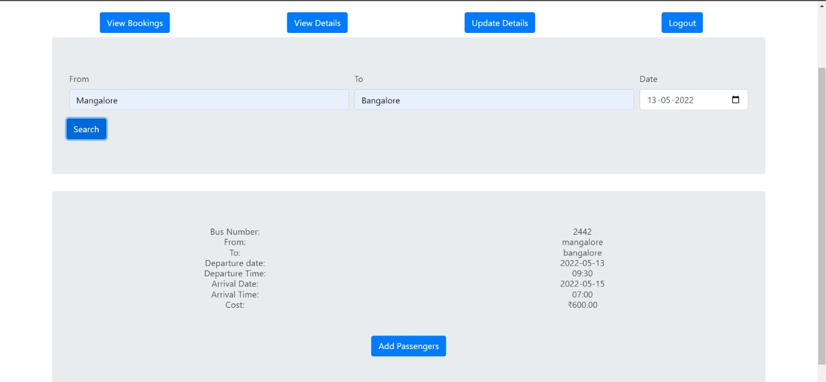
Project Screenshots
User schedule Page

Slide 18
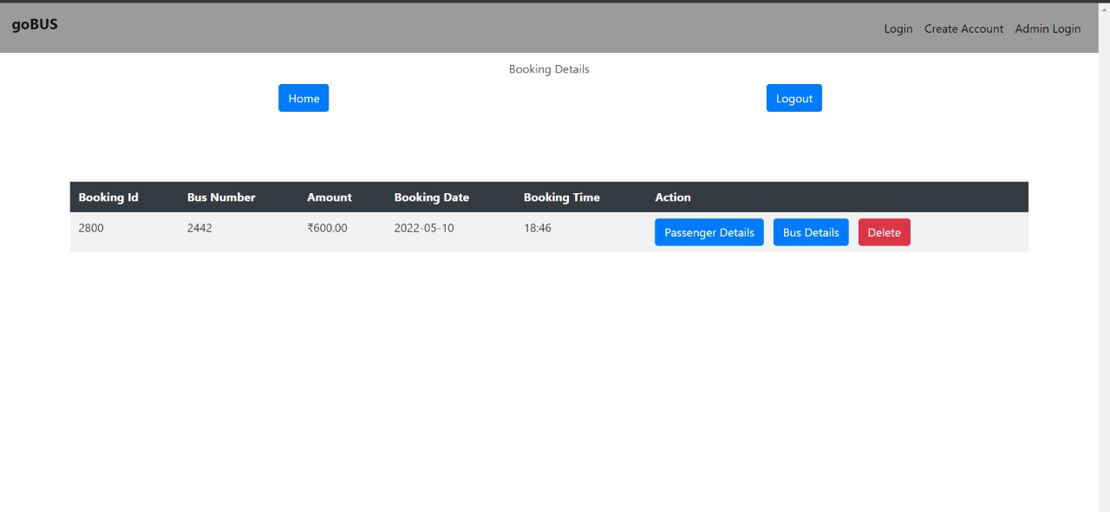
Project Screenshots
Booking Details Page

Slide 19
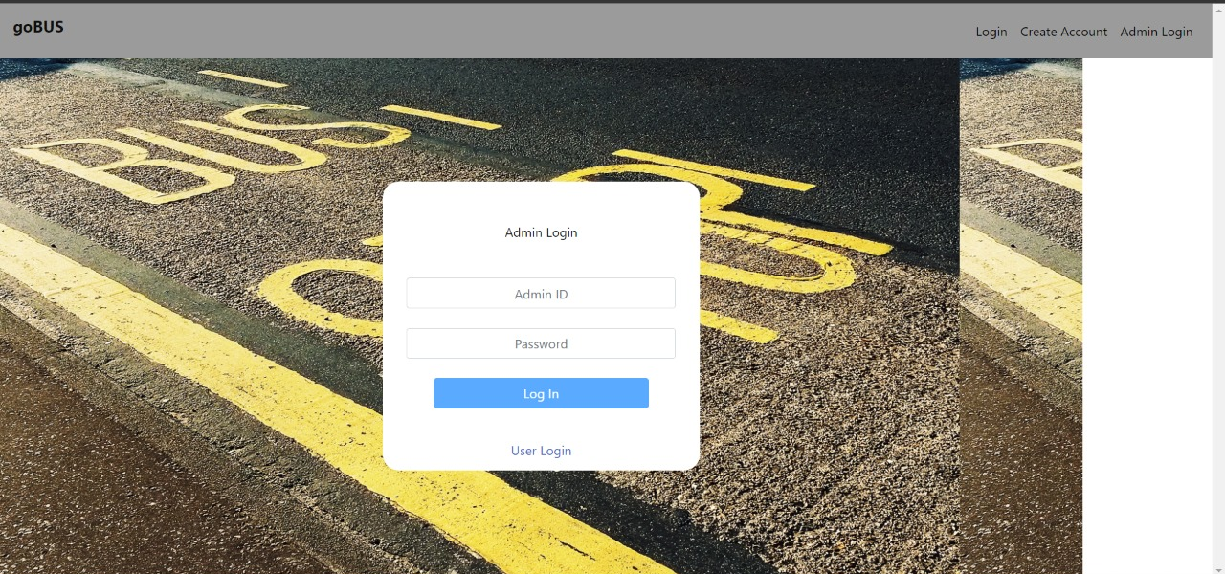
Project Screenshots
Admin Login Page

Slide 20
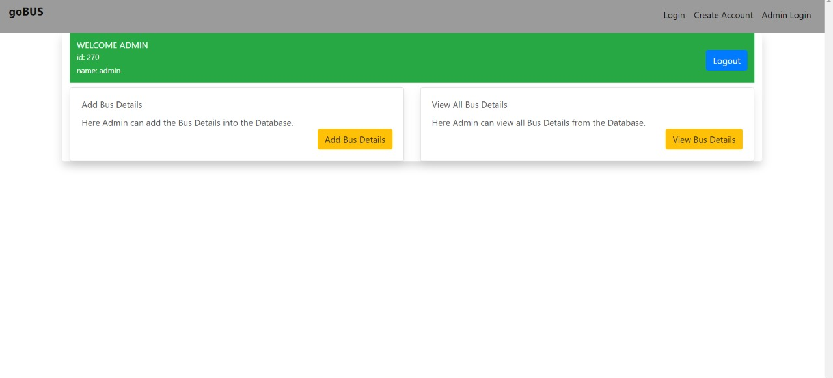
Project Screenshots
Admin Home Page

Slide 21
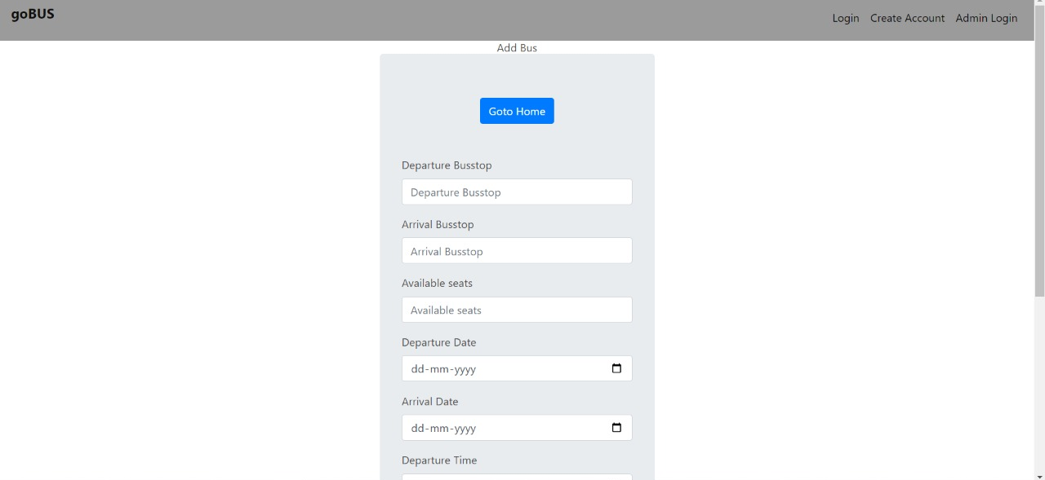
Project Screenshots
Admin Schedule Page

Slide 22
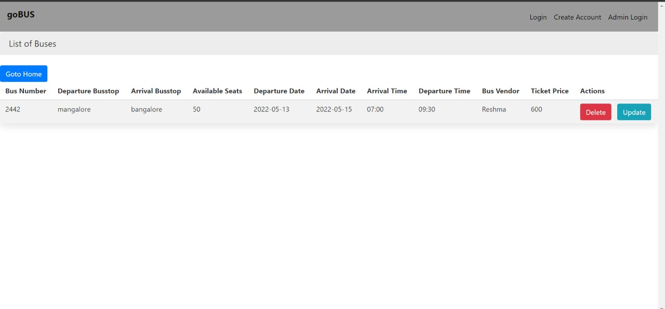
Project Screenshots
Bus List Page

Slide 23
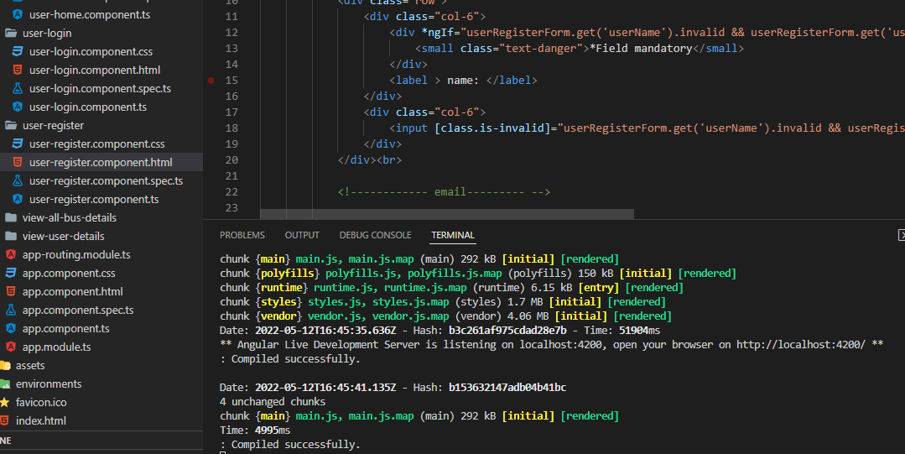
Run Application-Frontend
To run Front-end Spring Boot application on a default port 4200 run:
ng serve -0
If the ng command is not found install it using npm (-g flag will install it globally):
npm install -g @angular/cli

Slide 24
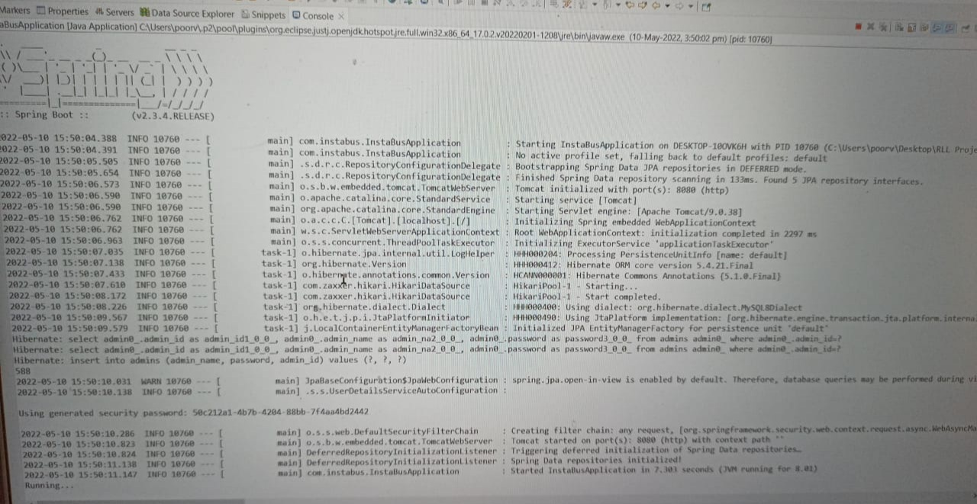
Run Application-Backend

Slide 25
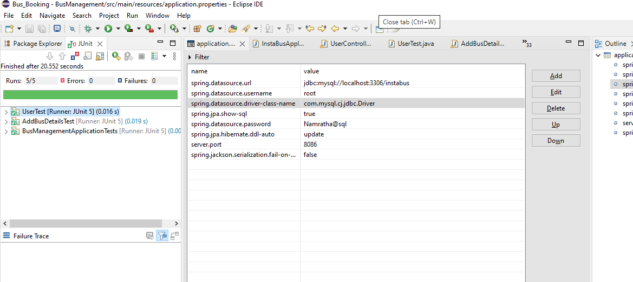
Testing
Unit Testing using JUnit

Slide 26
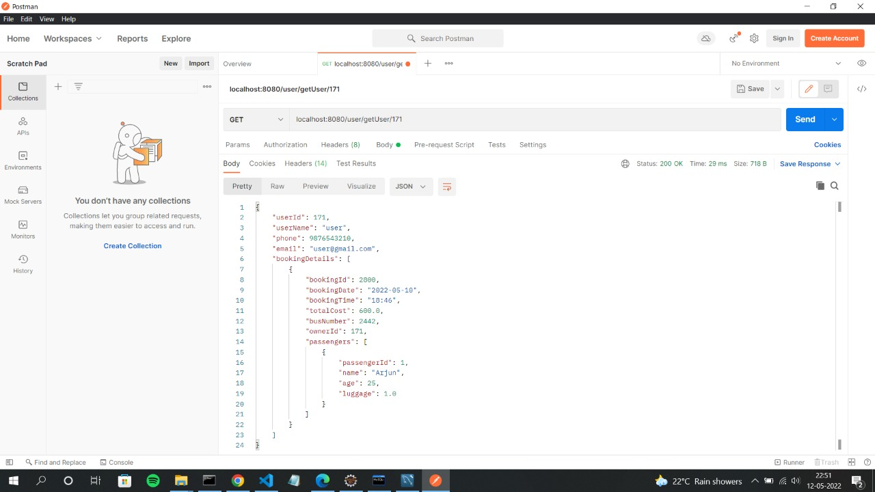
Testing
Functional Testing using Postman

Slide 27
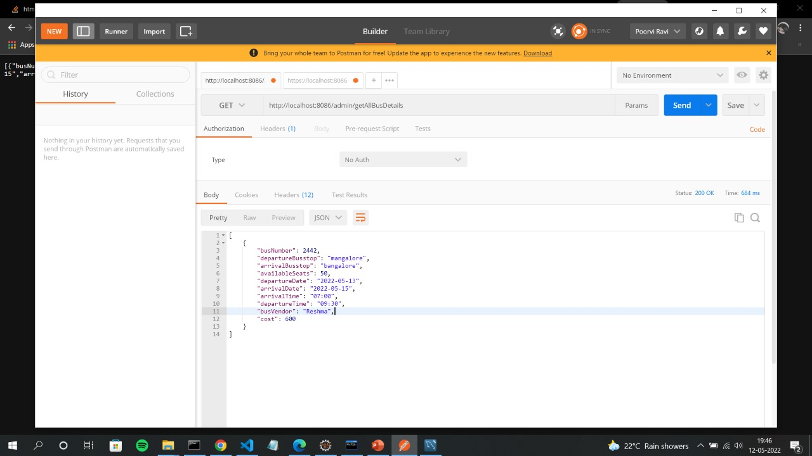
Testing
Functional Testing using Postman

Slide 28
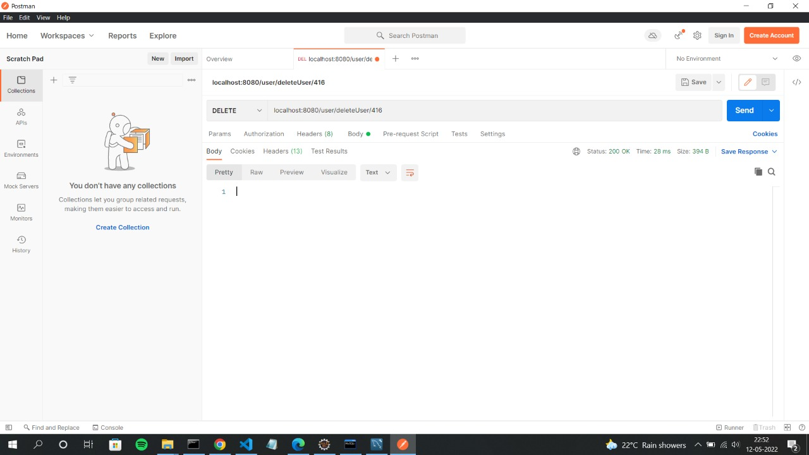
Testing
Functional Testing using Postman

Slide 29
Advantages
Allow users to search for buses and check availability of it.
Saves time with our current professional schedule and personal commitments.

Slide 30
Future Work
Add more user interface feature
Promotional Offer.
Commercialize the web app.

Slide 31
Conclusion
The main objective of the application is to understand the concept and implementation of Java, Spring Boot, Databases and Angular technology.
Our Project helps the user to search and book the buses online.

Slide 32
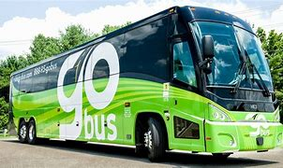
Thank You

